Slide 1


Marwadi University Faculty of Diploma Studies Computer Engineering Department
Skyfall
Sem 5
ProJect review
Prepared By:
DeviCharan Dasari(92100938019)
Adityaraj Chudasma(92100938023)
Smit Rudakiya(92100938029)
Vandit DOSHI(92100938050)
GUDIEd BY:
Prof.SUMIT MAKWANA
1

Slide 2
Content
Abstarct
Aim/Objective
Specific Requirements(Software/Hardware)
Functionality
User & Chacteristics
System Desgin(Diagram)
User Interface
Target Audience
List of Tables
Overview
References & Sources
2

Slide 3
Abstract
Gesture Fun is an exciting web-based game that allows users to control in-game actions using hand gestures. This interactive web app combines HTML, CSS, JavaScript, and python to create an engaging user interface. The game utilizes the user's webcam to capture hand movements, and computer vision techniques process these gestures in real-time.
The system demonstrates how the integration of a fairly accurate, light weight hand detection model can be used to track player hands and enable realtime body interactions. The web app enjoyment, offering players a unique way to interact with the game.
3

Slide 4
Aim/Objective
Our project is all about making technology feel like magic. Imagine using your computer, not with a keyboard or mouse, but by simply moving your hands in front of the camera. This document is like our treasure map, showing us the way to build this extraordinary software.
Its purpose is to spell out our project's goals, explain how the software will work, and set the rules we need to follow. Whether you're a developer, tester, or someone excited about our project, this document is your key to understanding what we're doing and how we're doing it.
4

Slide 5
Specific Requirements
SOFTWARE:
Web Browser
Any OS
HARDWARE:
Laptop
Computer
Web Cam
5

Slide 6
Functionality
WebApp Game: It’s a web app game and it concept is like old time but the new thing is gesture control and it will give user brand new experience to play game.
Gesture Control: In the game instead of keyboard, mouse, remote control. We will be going to use gesture control it will be new experience for user to play game like this.
Achievements: Achievements in gaming are specific goals or milestones that players can accomplish within a game. They serve several purposes, such as motivating players, extending gameplay, and providing a sense of accomplishment.They can significantly enhance the overall gaming experience and player engagement.
6

Slide 7
User & Characteristics
Players: These are the primary users of our skyfall game. They can be people of various ages and enjoy interactive and engaging gaming experiences. Characteristics include a various difficulty of game.
Developers: The individuals responsible for building and maintaining the web application. They need technical proficiency in web development, computer vision, and programming languages like HTML, CSS, PHP, JavaScript and Python.
7

Slide 8
Desginers: Game designers are responsible for defining the overall gameplay, mechanics, and rules of the game. They design levels, challenges, and the overall player experience, including how gestures are integrated into the gameplay.
Testers: Individuals tasked with ensuring the application functions correctly and meets quality standards. They require attention to detail and an understanding of testing procedures.
8

Slide 9
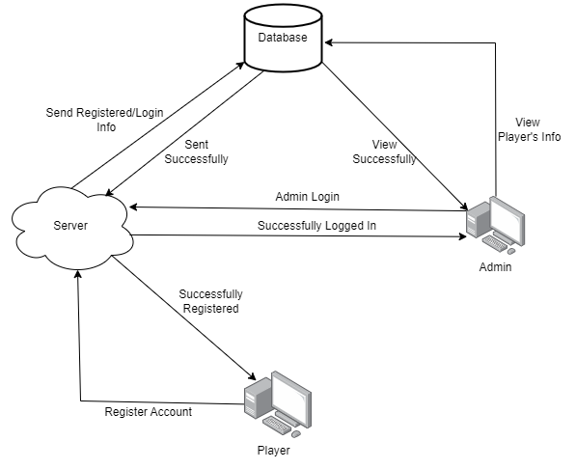
System Desgin
9

Slide 10
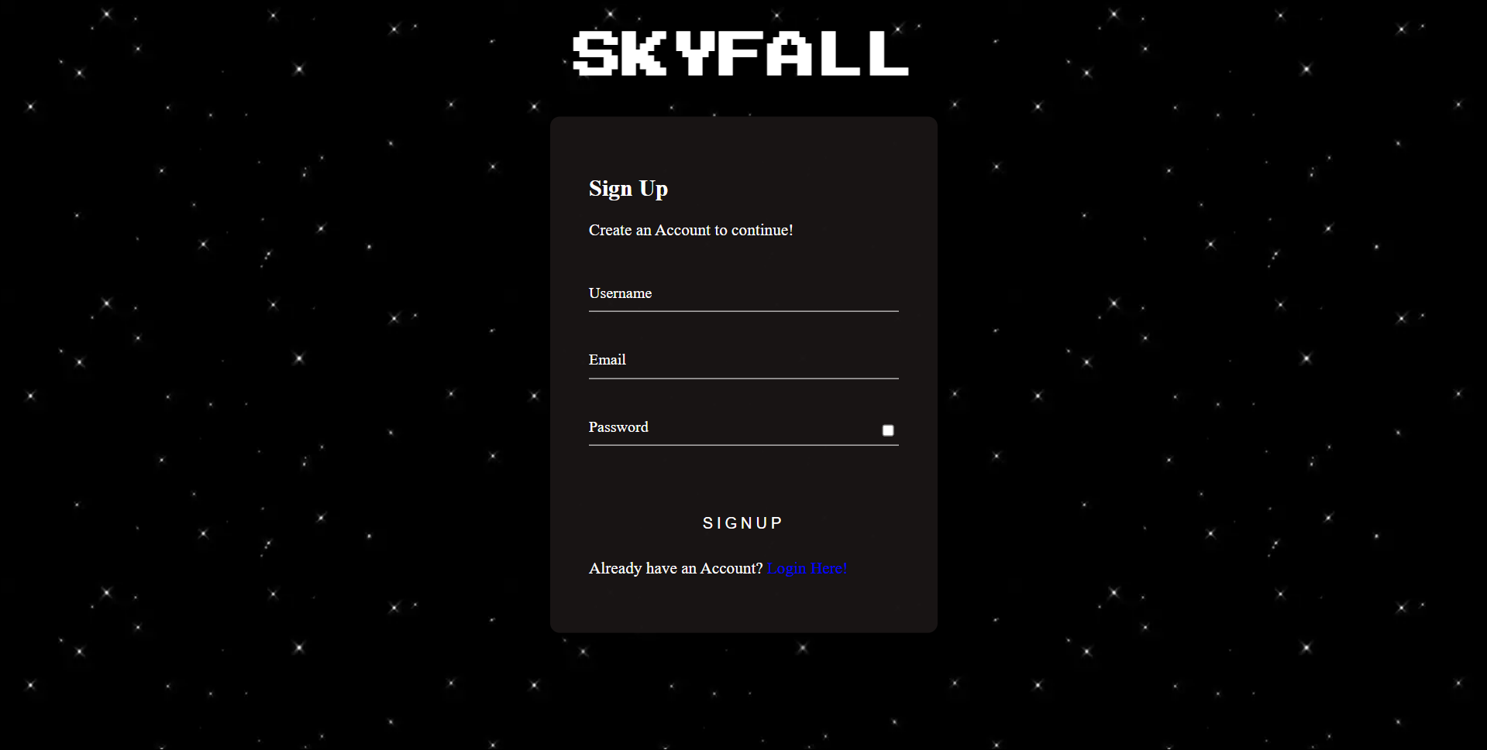
User Interface
1.Registeration Page
10

Slide 11
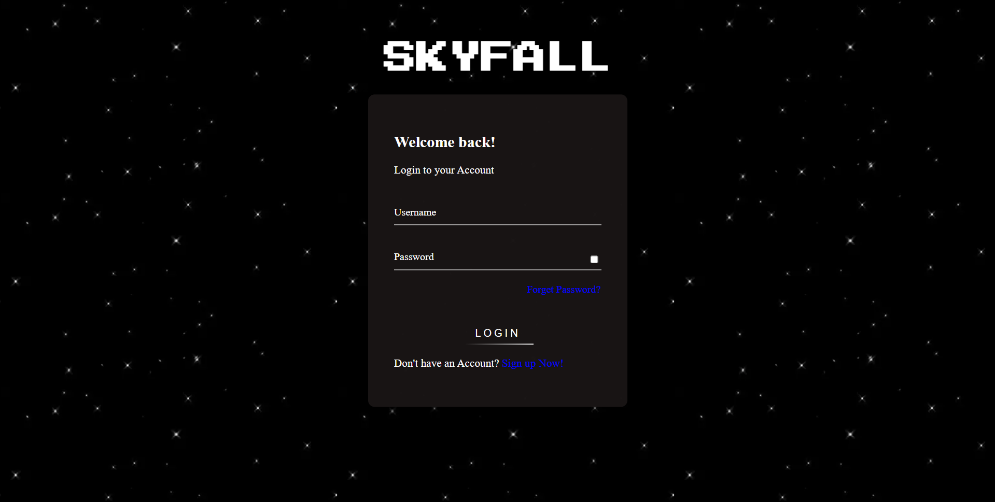
User Interface
2.Login Page
11

Slide 12
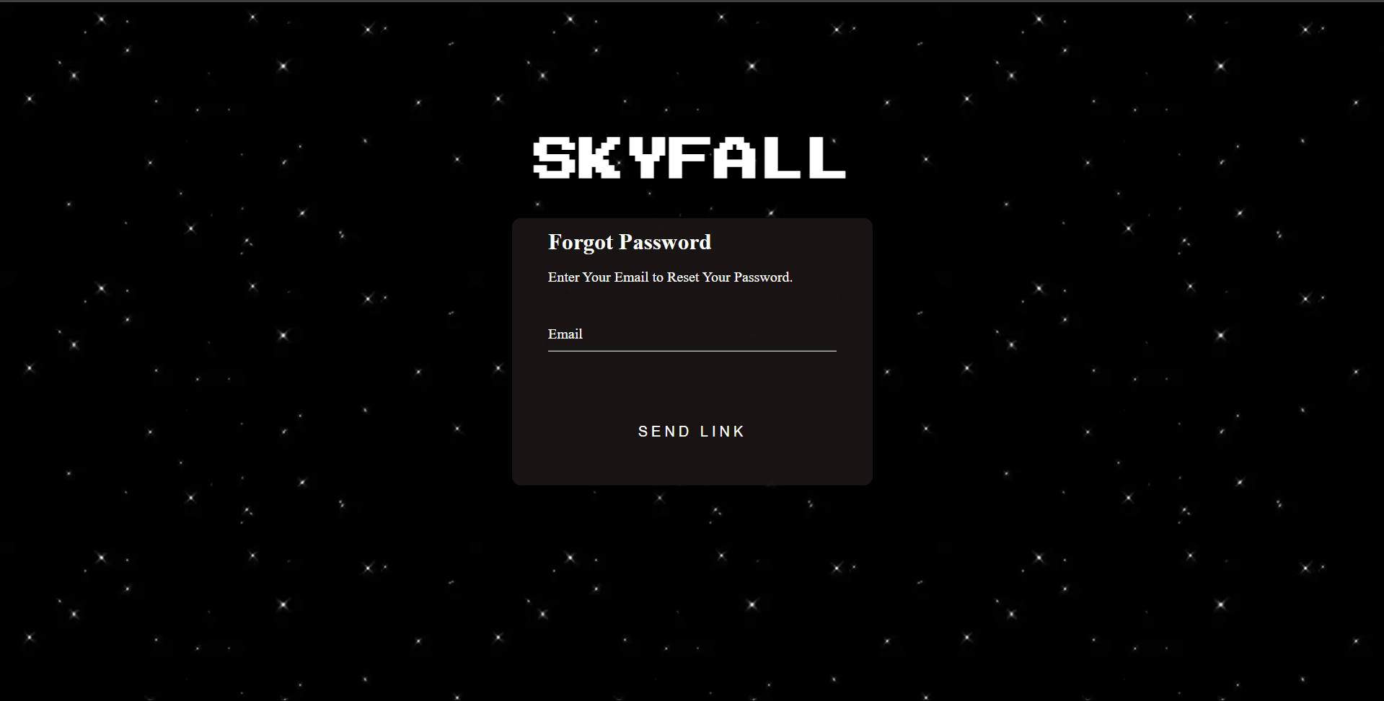
User Interface
3.Forget Password
12

Slide 13
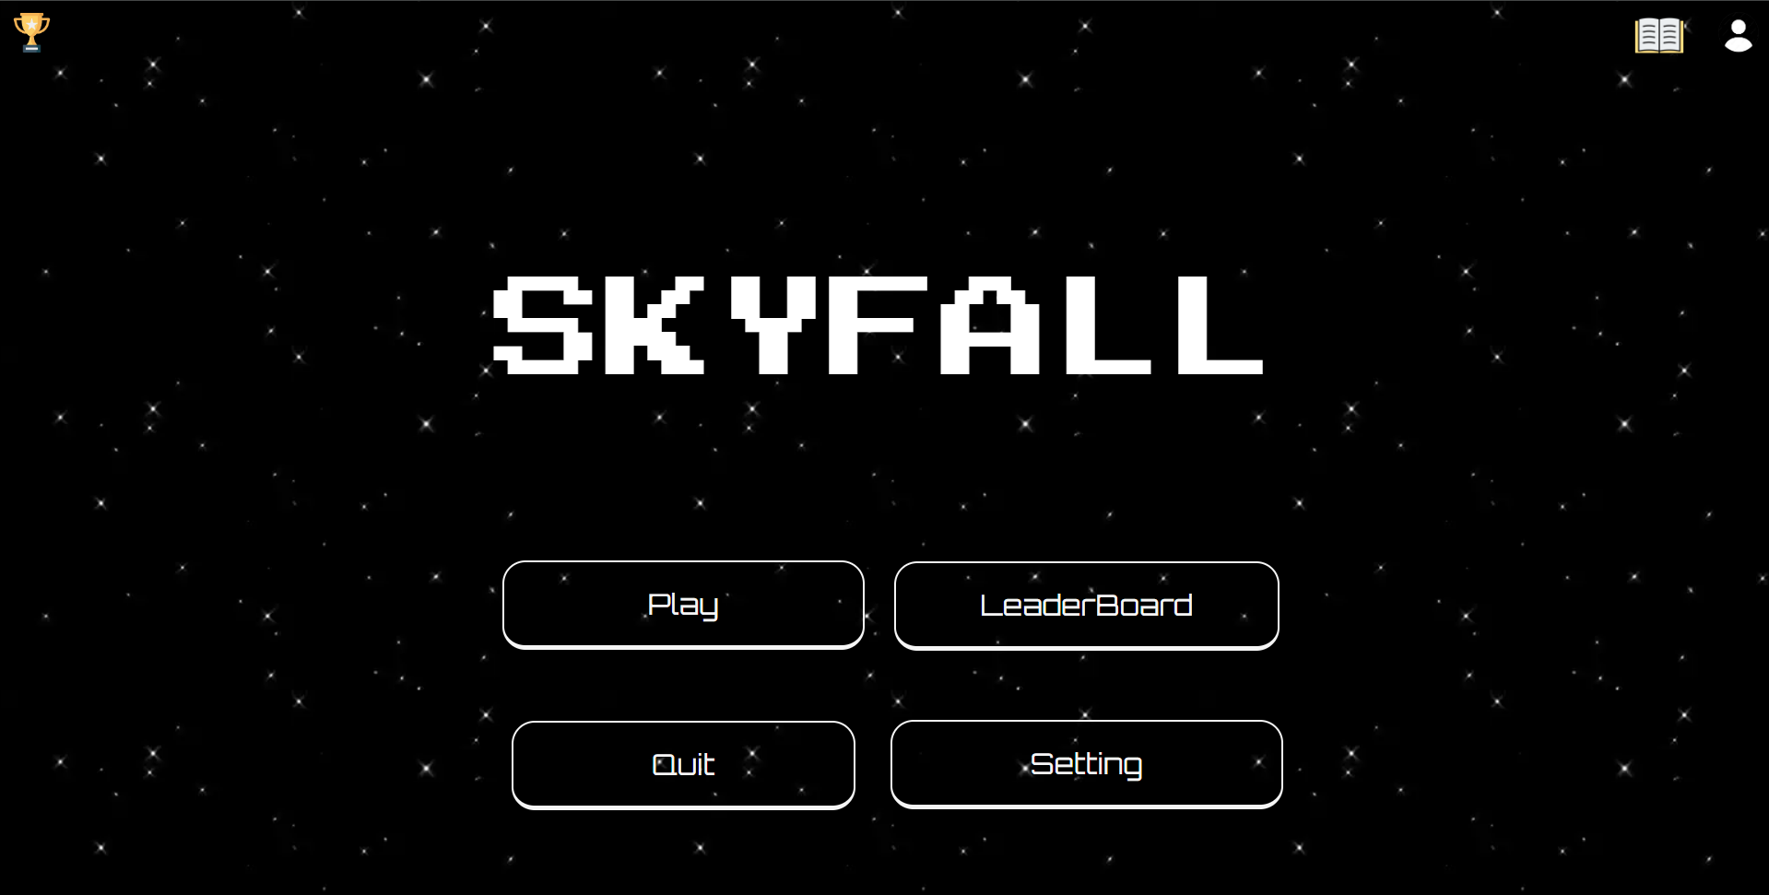
User Interface
3.Home Page
13

Slide 14
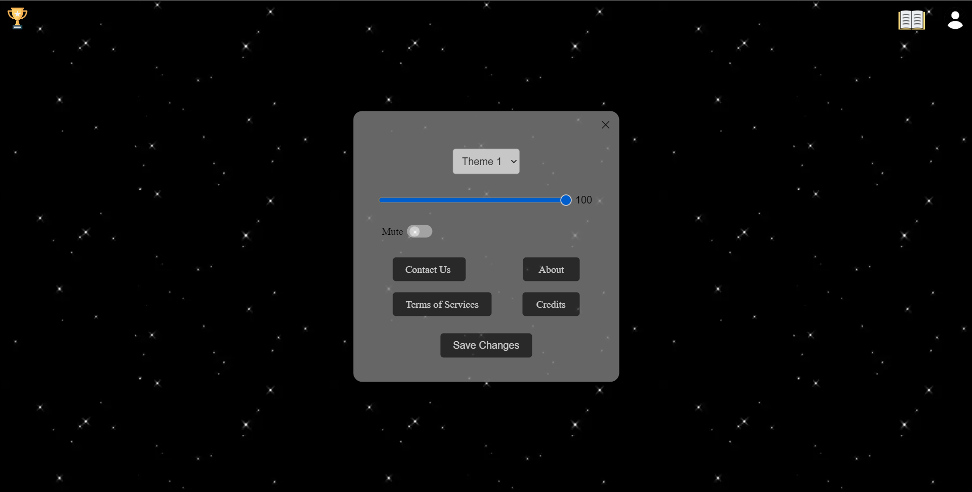
User Interface
4.Settings
14

Slide 15
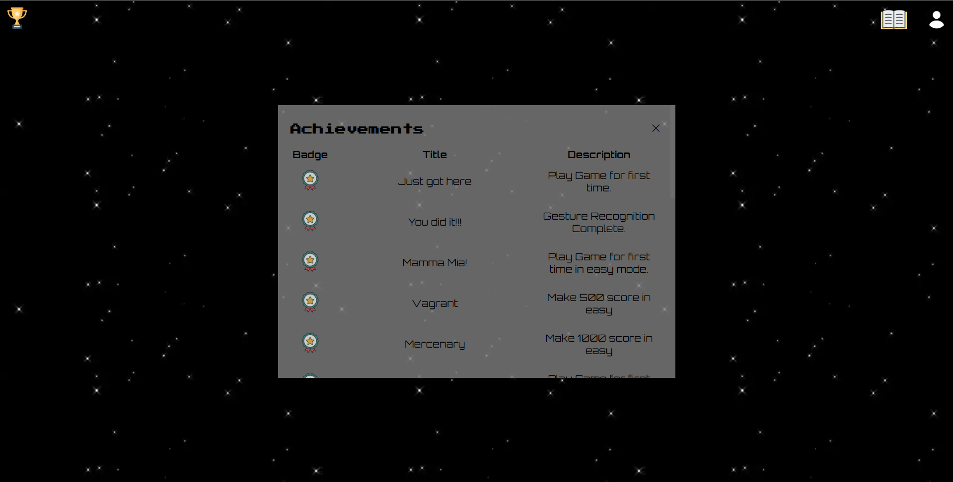
User Interface
5.Achievements Section
15

Slide 16
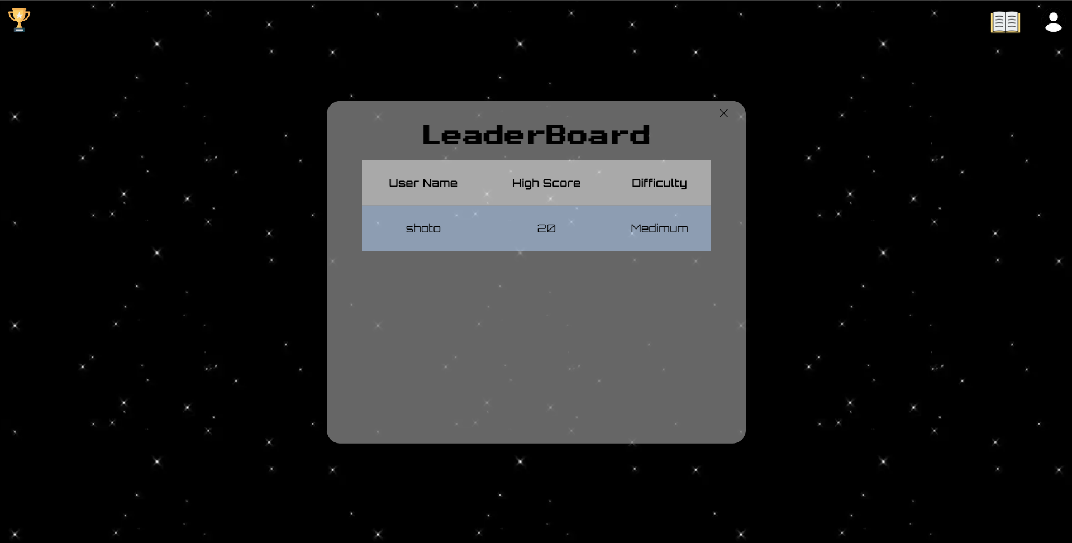
User Interface
6.Leaderboard Section
16

Slide 17
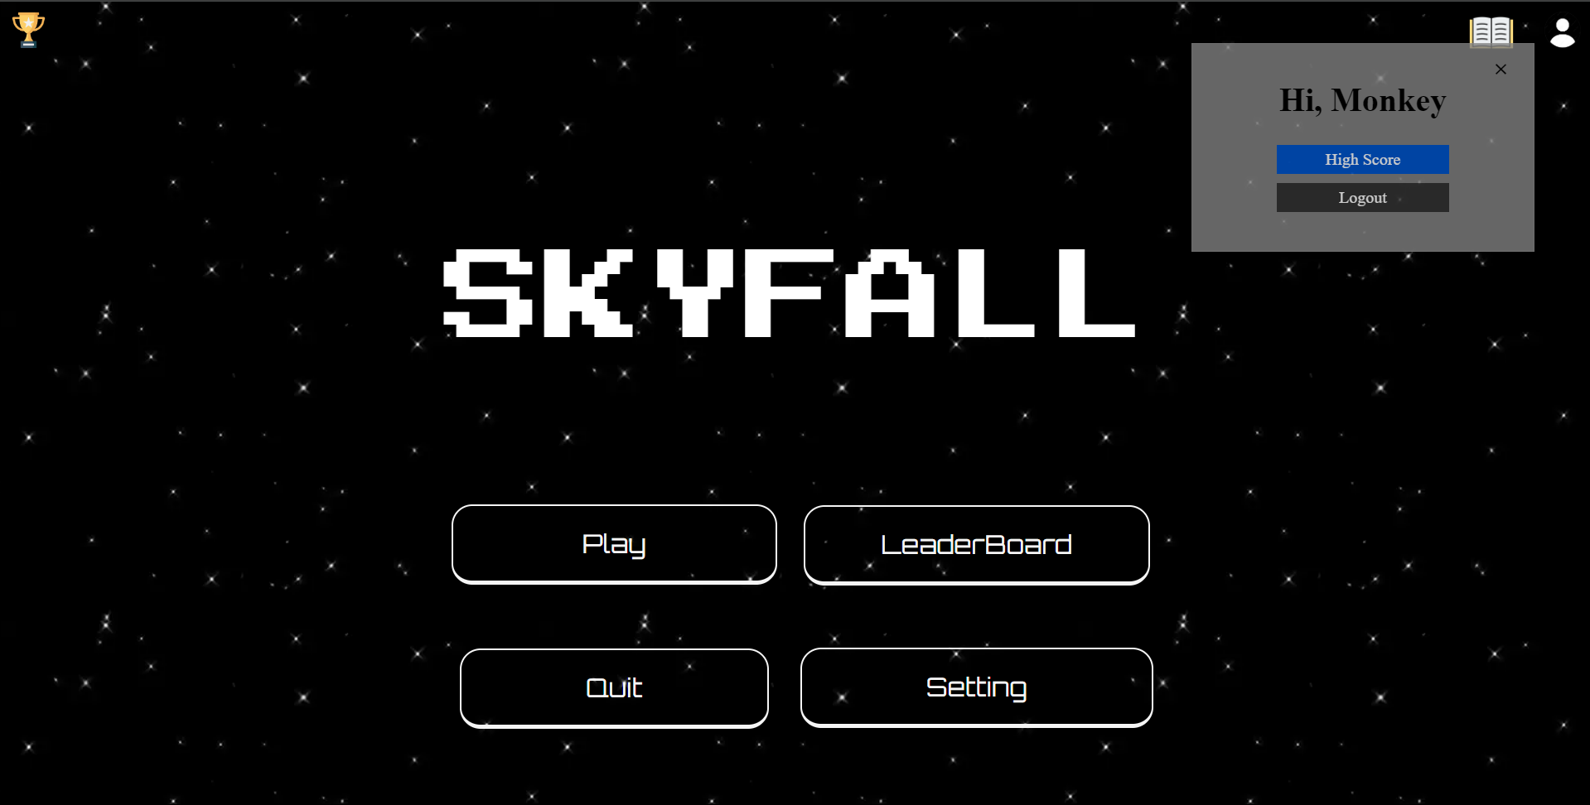
User Interface
7.Profile Section
17

Slide 18
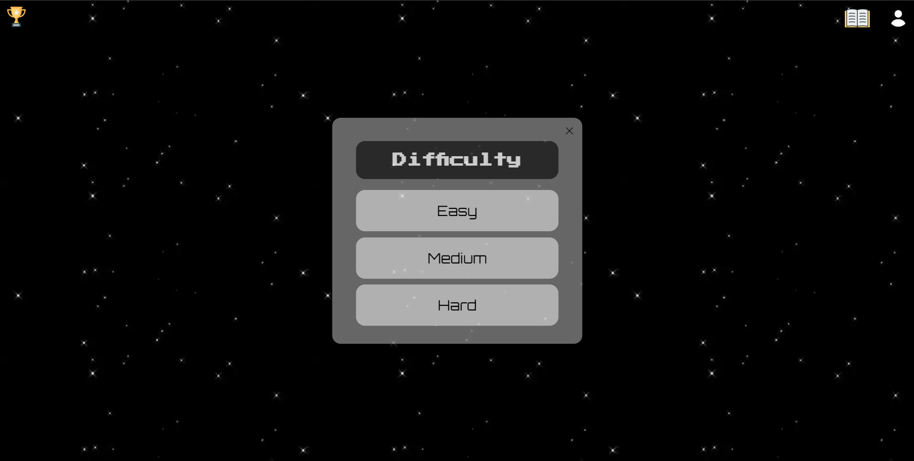
User Interface
8.Difficulties
18

Slide 19
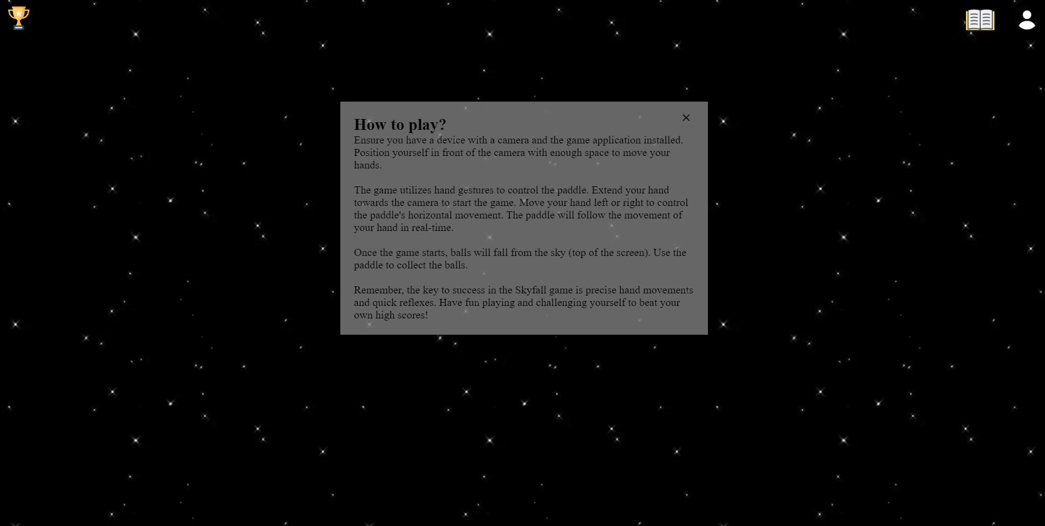
User Interface
9.Instructions/Guide Book
19

Slide 20
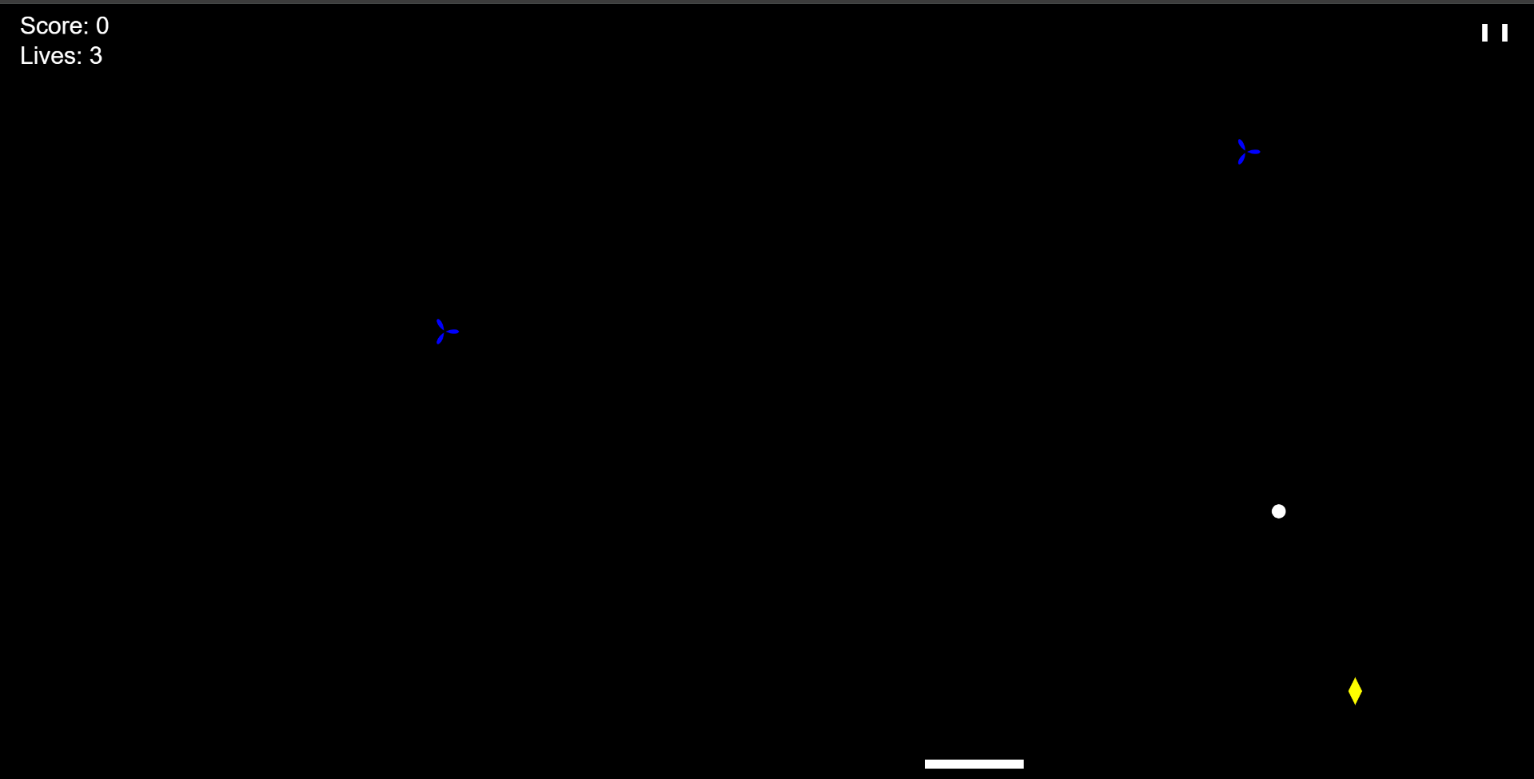
User Interface
10.Play Interface
20

Slide 21
Target Audience
Describe the primary target audience, which includes gamers of a certain age group, interests, and gaming preferences or are you targeting casual game.
21

Slide 22
List of Tables
1)Player Login Table
2)Player High Score Table
3)Achievements Table
4)Leaderboard Table
22

Slide 23
OVERVIEW
Overall, a gesture control web-based game is an interactive game that enables players to control in-game actions and interactions using gestures,typically detected by a webcam. This innovative approach replaces traditional input methods like keyboard or mouse with real-world movements, allowing players to immerse themselves in the game by translating their gestures into on-screen actions.
Developers must create gesture recognition algorithms, optimize performance across various devices and browsers, and ensure a responsive feedback system to deliver an engaging gaming experience. Gesture control enhances gaming by introducing new ways to interact with games. It presents challenges such as accuracy, accessibility, and the need for specialized hardware, making it essential for developers to strike a balance between innovation and usability to create a successful and inclusive gaming experience.
23

Slide 24
References & Sources
1.Developers:-https://developers.google.com/mediapipe/solutions/vision/gesture_recognizer/web_js
2.geeksforgeeks:- https://www.geeksforgeeks.org/project-idea-hand-web-browser/
3.towardsdatascience:- https://towardsdatascience.com/gentle-introduction-to-2d-hand-pose-estimation-approach-explained-4348d6d79b11
4. makeuseof:- https://www.makeuseof.com/browser-windows-macos-chromeos-uses-least-ram-cpu/
5. w3school:- https://www.w3schools.com/
6. http://ethesis.nitrkl.ac.in/6055/1/110ID0520-14.pdf
7. https://www.ijsr.net/archive/v11i10/SR221025224232.pdf
24

Slide 25
Thank you!
25

Slide 26
Any Questions?
26

